Slide 1
18-447 Computer Architecture Lecture 16: Systolic Arrays & Static Scheduling
Prof. Onur Mutlu
Carnegie Mellon University
Spring 2015, 2/23/2015

Slide 2
Agenda for Today & Next Few Lectures
Single-cycle Microarchitectures
Multi-cycle and Microprogrammed Microarchitectures
Pipelining
Issues in Pipelining: Control & Data Dependence Handling, State Maintenance and Recovery, …
Out-of-Order Execution
Issues in OoO Execution: Load-Store Handling, …
Alternative Approaches to Instruction Level Parallelism

Slide 3
Approaches to (Instruction-Level) Concurrency
Pipelining
Out-of-order execution
Dataflow (at the ISA level)
SIMD Processing (Vector and array processors, GPUs)
VLIW
Decoupled Access Execute
Systolic Arrays
Static Instruction Scheduling

Slide 4
Homework 3.1: Feedback Form
Due Today!
I would like your feedback on the course
Easy to fill in
Can submit anonymously, if you wish
Worth 0.25% of your grade (extra credit)
Need to get checked off after submitting to get your grade points
Can email
If anonymous, show that you are turning in and have a TA check you off

Slide 5
A Few Things
Midterm I Date
March 18 or 20
Collaboration on Labs
All labs individual – no collaboration permitted
Collaboration on homeworks
You can collaborate
But need to submit individual writeups on your own

Slide 6
Wednesday Seminar – Noon-1pm GHC 6115
Data Center Computers: Modern Challenges in CPU Design
Richard Sites, Google
Feb 25, noon-1pm, GHC 6115
Computers used as datacenter servers have usage patterns that differ substantially from those of desktop or laptop computers. We discuss four key differences in usage and their first-order implications for designing computers that are particularly well-suited as servers: data movement, thousands of transactions per second, program isolation, and measurement underpinnings.
Maintaining high-bandwidth data movement requires coordinated design decisions throughout the memory system, instruction-issue system, and even instruction set. Serving thousands of transactions per second requires continuous attention to all sources of delay -- causes of long-latency transactions. Unrelated programs running on shared hardware produce delay through undesired interference; isolating programs from one another needs further hardware help. And finally, when running datacenter servers as a business it is vital to be able to observe and hence decrease inefficiencies across dozens of layers of software and thousands of interacting servers. There are myriad open research problems related to these issues.

Slide 7
Isolating Programs from One Another
Remember matlab vs. gcc?
We will get back to this again
In the meantime, if you are curious, take a look at:
Subramanian et al., “MISE: Providing Performance Predictability and Improving Fairness in Shared Main Memory Systems,” HPCA 2013.
Moscibroda and Mutlu, “Memory Performance Attacks: Denial of Memory Service in Multi-Core Systems,” USENIX Security 2007.

Slide 8
Recap of Last Lecture
GPUs
Programming Model vs. Execution Model Separation
GPUs: SPMD programming on SIMD/SIMT hardware
SIMT Advantages vs. Traditional SIMD
Warps, Fine-grained Multithreading of Warps
SIMT Memory Access
Branch Divergence Problem in SIMT
Dynamic Warp Formation/Merging
VLIW
Philosophy: RISC and VLIW
VLIW vs. SIMD vs. Superscalar
Tradeoffs and Advantages
DAE (Decoupled Access/Execute)
Dynamic and Static Scheduling

Slide 9
Systolic Arrays

Slide 10
Systolic Arrays: Motivation
Goal: design an accelerator that has
Simple, regular design (keep # unique parts small and regular)
High concurrency → high performance
Balanced computation and I/O (memory) bandwidth
Idea: Replace a single processing element (PE) with a regular array of PEs and carefully orchestrate flow of data between the PEs
such that they collectively transform a piece of input data before outputting it to memory
Benefit: Maximizes computation done on a single piece of data element brought from memory

Slide 11
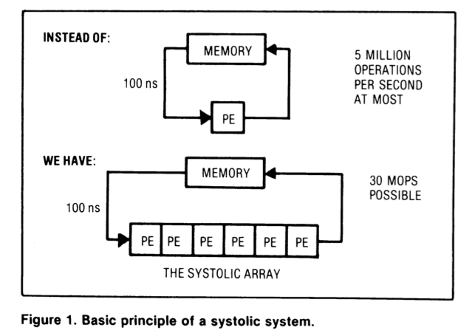
Systolic Arrays
Memory: heart
PEs: cells
Memory pulses
data through
cells
H. T. Kung, “Why Systolic Architectures?,” IEEE Computer 1982.

Slide 12
Why Systolic Architectures?
Idea: Data flows from the computer memory in a rhythmic fashion, passing through many processing elements before it returns to memory
Similar to an assembly line of processing elements
Different people work on the same car
Many cars are assembled simultaneously
Can be two-dimensional
Why? Special purpose accelerators/architectures need
Simple, regular design (keep # unique parts small and regular)
High concurrency → high performance
Balanced computation and I/O (memory) bandwidth

Slide 13
Systolic Architectures
Basic principle: Replace a single PE with a regular array of PEs and carefully orchestrate flow of data between the PEs
Balance computation and memory bandwidth
Differences from pipelining:
These are individual PEs
Array structure can be non-linear and multi-dimensional
PE connections can be multidirectional (and different speed)
PEs can have local memory and execute kernels (rather than a piece of the instruction)

Slide 14
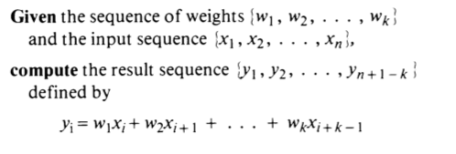
Systolic Computation Example
Convolution
Used in filtering, pattern matching, correlation, polynomial evaluation, etc …
Many image processing tasks

Slide 15
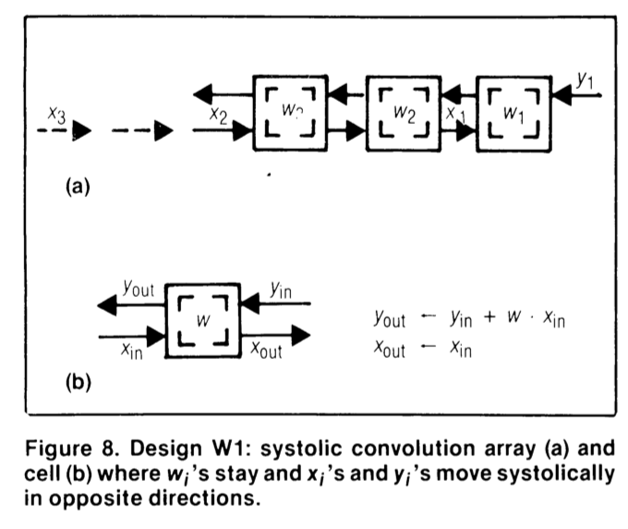
Systolic Computation Example: Convolution
y1 = w1x1 + w2x2 + w3x3
y2 = w1x2 + w2x3 + w3x4
y3 = w1x3 + w2x4 + w3x5

Slide 16
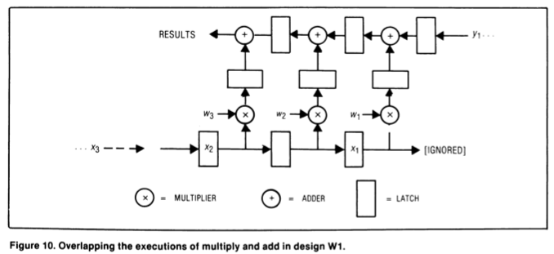
Systolic Computation Example: Convolution
Worthwhile to implement adder and multiplier separately to allow overlapping of add/mul executions

Slide 17
Systolic Computation Example: Convolution
One needs to carefully orchestrate when data elements are input to the array
And when output is buffered
This gets more involved when
Array dimensionality increases
PEs are less predictable in terms of latency

Slide 18
Systolic Arrays: Pros and Cons
Advantage:
Specialized (computation needs to fit PE organization/functions)
→ improved efficiency, simple design, high concurrency/ performance
→ good to do more with less memory bandwidth requirement
Downside:
Specialized
→ not generally applicable because computation needs to fit the PE functions/organization

Slide 19
More Programmability
Each PE in a systolic array
Can store multiple “weights”
Weights can be selected on the fly
Eases implementation of, e.g., adaptive filtering
Taken further
Each PE can have its own data and instruction memory
Data memory → to store partial/temporary results, constants
Leads to stream processing, pipeline parallelism
More generally, staged execution

Slide 20
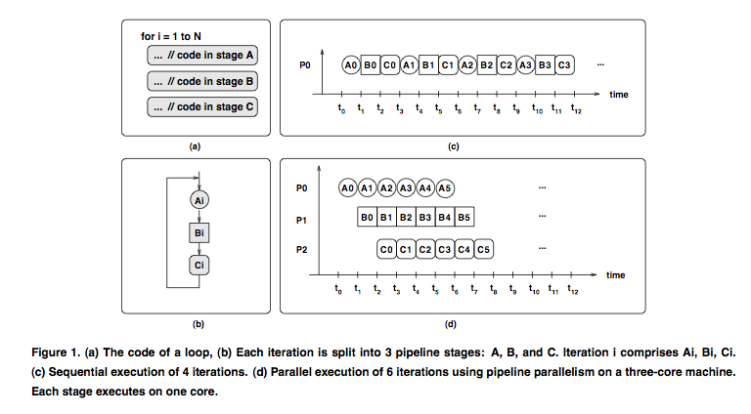
Pipeline Parallelism

Slide 21
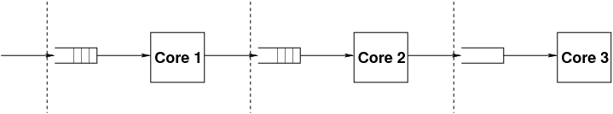
Stages of Pipelined Programs
Loop iterations are divided into code segments called stages
Threads execute stages on different cores
A
B
C
loop {
Compute1
Compute2
Compute3
}
A
B
C

Slide 22
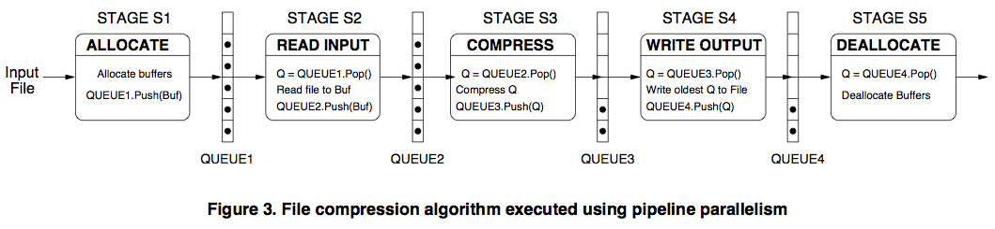
Pipelined File Compression Example

Slide 23
Systolic Array
Advantages
Makes multiple uses of each data item → reduced need for fetching/refetching
High concurrency
Regular design (both data and control flow)
Disadvantages
Not good at exploiting irregular parallelism
Relatively special purpose → need software, programmer support to be a general purpose model

Slide 24
Example Systolic Array: The WARP Computer
HT Kung, CMU, 1984-1988
Linear array of 10 cells, each cell a 10 Mflop programmable processor
Attached to a general purpose host machine
HLL and optimizing compiler to program the systolic array
Used extensively to accelerate vision and robotics tasks
Annaratone et al., “Warp Architecture and Implementation,” ISCA 1986.
Annaratone et al., “The Warp Computer: Architecture, Implementation, and Performance,” IEEE TC 1987.

Slide 25
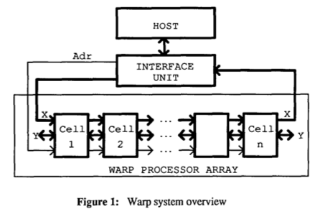
The WARP Computer

Slide 26
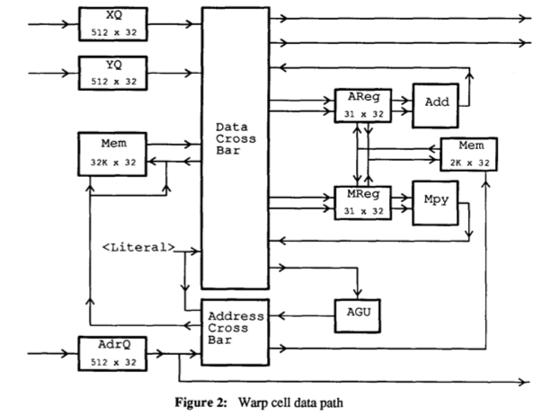
The WARP Cell

Slide 27
Systolic Arrays vs. SIMD
Food for thought…

Slide 28
Agenda Status
Single-cycle Microarchitectures
Multi-cycle and Microprogrammed Microarchitectures
Pipelining
Issues in Pipelining: Control & Data Dependence Handling, State Maintenance and Recovery, …
Out-of-Order Execution
Issues in OoO Execution: Load-Store Handling, …
Alternative Approaches to Instruction Level Parallelism

Slide 29
Approaches to (Instruction-Level) Concurrency
Pipelining
Out-of-order execution
Dataflow (at the ISA level)
SIMD Processing (Vector and array processors, GPUs)
VLIW
Decoupled Access Execute
Systolic Arrays
Static Instruction Scheduling

Slide 30
Some More Recommended Readings
Fisher, “Very Long Instruction Word architectures and the ELI-512,” ISCA 1983.
Smith, “Decoupled Access/Execute Compute Architectures,” ISCA 1982, ACM TOCS 1984.
H. T. Kung, “Why Systolic Architectures?,” IEEE Computer 1982.
Huck et al., “Introducing the IA-64 Architecture,” IEEE Micro 2000.
Rau and Fisher, “Instruction-level parallel processing: history, overview, and perspective,” Journal of Supercomputing, 1993.
Faraboschi et al., “Instruction Scheduling for Instruction Level Parallel Processors,” Proc. IEEE, Nov. 2001.

Slide 31
Static Instruction Scheduling (with a Slight Focus on VLIW)

Slide 32
Agenda
Static Scheduling
Key Questions and Fundamentals
Enabler of Better Static Scheduling: Block Enlargement
Predicated Execution
Loop Unrolling
Trace
Superblock
Hyperblock
Block-structured ISA

Slide 33
Key Questions
Q1. How do we find independent instructions to fetch/execute?
Q2. How do we enable more compiler optimizations?
e.g., common subexpression elimination, constant propagation, dead code elimination, redundancy elimination, …
Q3. How do we increase the instruction fetch rate?
i.e., have the ability to fetch more instructions per cycle
A: Enabling the compiler to optimize across a larger number of instructions that will be executed straight line (without branches getting in the way) eases all of the above

Slide 34
How Do We Enable Straight-Line Code?
Get rid of control flow
Predicated Execution
Loop Unrolling
…
Optimize frequently executed control flow paths
Trace
Superblock
Hyperblock
Block-structured ISA
…

Slide 35
Review: Predication (Predicated Execution)
Idea: Compiler converts control dependence into data dependence → branch is eliminated
Each instruction has a predicate bit set based on the predicate computation
Only instructions with TRUE predicates are committed (others turned into NOPs)
(normal branch code)
(predicated code)
A
T
N
A
if (cond) {
b = 0;
}
else {
b = 1;
}
C
B
B
C
D
D
A
p1 = (cond)
branch p1, TARGET
A
p1 = (cond)
(!p1) mov b, 1
(p1) mov b, 0
B
B
mov b, 1
jmp JOIN
C
C
TARGET:
mov b, 0
D
add x, b, 1
D
add x, b, 1

Slide 36
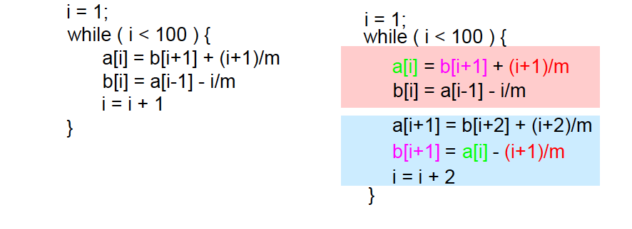
Review: Loop Unrolling
Idea: Replicate loop body multiple times within an iteration
+ Reduces loop maintenance overhead
Induction variable increment or loop condition test
+ Enlarges basic block (and analysis scope)
Enables code optimization and scheduling opportunities
-- What if iteration count not a multiple of unroll factor? (need extra code to detect this)
-- Increases code size

Slide 37
Some Terminology: Basic vs. Atomic Block
Basic block: A sequence (block) of instructions with a single control flow entry point and a single control flow exit point
A basic block executes uninterrupted (if no exceptions/interrupts)
Atomic block: A block of instructions where either all instructions complete or none complete
In most modern ISAs, the atomic unit of execution is at the granularity of an instruction
A basic block can be considered atomic (if there are no exceptions/interrupts and side effects observable in the middle of execution)
One can reorder instructions freely within an atomic block, subject only to true data dependences

Slide 38
VLIW: Finding Independent Operations
Within a basic block, there is limited instruction-level parallelism (if the basic block is small)
To find multiple instructions to be executed in parallel, the compiler needs to consider multiple basic blocks
Problem: Moving an instruction above a branch is unsafe because instruction is not guaranteed to be executed
Idea: Enlarge blocks at compile time by finding the frequently-executed paths
Trace scheduling
Superblock scheduling
Hyperblock scheduling

Slide 39
Safety and Legality in Code Motion
Two characteristics of speculative code motion:
Safety: whether or not spurious exceptions may occur
Legality: whether or not result will be always correct
Four possible types of code motion:

Slide 40
Code Movement Constraints
Downward
When moving an operation from a BB to one of its dest BB’s,
all the other dest basic blocks should still be able to use the result of the operation
the other source BB’s of the dest BB should not be disturbed
Upward
When moving an operation from a BB to its source BB’s
register values required by the other dest BB’s must not be destroyed
the movement must not cause new exceptions

Slide 41
Trace Scheduling
Trace: A frequently executed path in the control-flow graph (has multiple side entrances and multiple side exits)
Idea: Find independent operations within a trace to pack into VLIW instructions.
Traces determined via profiling
Compiler adds fix-up code for correctness (if a side entrance or side exit of a trace is exercised at runtime, corresponding fix-up code is executed)

Slide 42
Trace Scheduling (II)
There may be conditional branches from the middle of the trace (side exits) and transitions from other traces into the middle of the trace (side entrances).
These control-flow transitions are ignored during trace scheduling.
After scheduling, fix-up/bookkeeping code is inserted to ensure the correct execution of off-trace code.
Fisher, “Trace scheduling: A technique for global microcode compaction,” IEEE TC 1981.

Slide 43
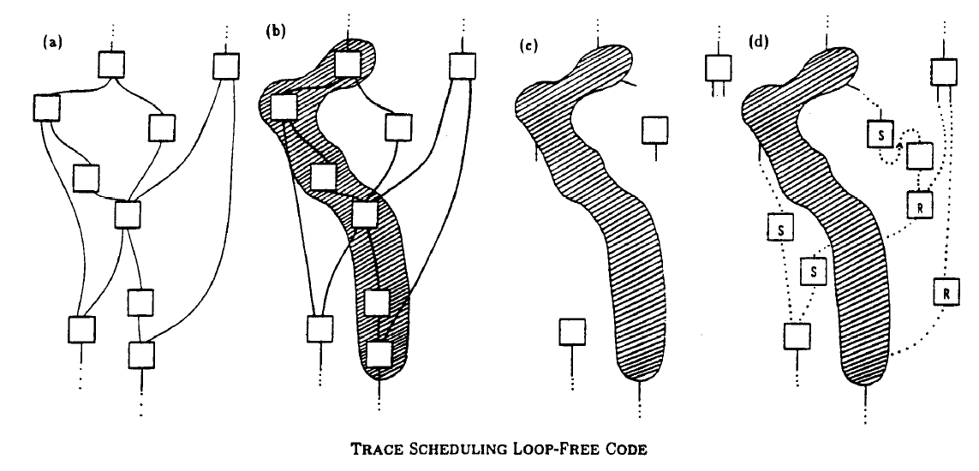
Trace Scheduling Idea

Slide 44
Trace Scheduling (III)
Instr 1
Instr 2
Instr 2
Instr 3
Instr 3
Instr 4
Instr 4
Instr 1
Instr 5
Instr 5
What bookeeping is required when Instr 1
is moved below the side entrance in the trace?

Slide 45
Trace Scheduling (IV)
Instr 3
Instr 1
Instr 2
Instr 4
Instr 2
Instr 3
Instr 3
Instr 4
Instr 4
Instr 1
Instr 5
Instr 5

Slide 46
Trace Scheduling (V)
Instr 1
Instr 1
Instr 2
Instr 5
Instr 3
Instr 2
Instr 4
Instr 3
Instr 5
Instr 4
What bookeeping is required when Instr 5
moves above the side entrance in the trace?

Slide 47
Trace Scheduling (VI)
Instr 5
Instr 1
Instr 1
Instr 2
Instr 5
Instr 3
Instr 2
Instr 4
Instr 3
Instr 5
Instr 4

Slide 48
Trace Scheduling Fixup Code Issues
Sometimes need to copy instructions more than once to ensure correctness on all paths (see C below)

Slide 49
Trace Scheduling Overview
Trace Selection
select seed block (the highest frequency basic block)
extend trace (along the highest frequency edges)
forward (successor of the last block of the trace)
backward (predecessor of the first block of the trace)
don’t cross loop back edge
bound max_trace_length heuristically
Trace Scheduling
build data precedence graph for a whole trace
perform list scheduling and allocate registers
add compensation code to maintain semantic correctness
Speculative Code Motion (upward)
move an instruction above a branch if safe

Slide 50
Data Precedence Graph

Slide 51
List Scheduling
Assign priority to each instruction
Initialize ready list that holds all ready instructions
Ready = data ready and can be scheduled
Choose one ready instruction I from ready list with the highest priority
Possibly using tie-breaking heuristics
Insert I into schedule
Making sure resource constraints are satisfied
Add those instructions whose precedence constraints are now satisfied into the ready list

Slide 52
Instruction Prioritization Heuristics
Number of descendants in precedence graph
Maximum latency from root node of precedence graph
Length of operation latency
Ranking of paths based on importance
Combination of above

Slide 53
VLIW List Scheduling
Assign Priorities
Compute Data Ready List (DRL) - all operations whose predecessors have been scheduled.
Select from DRL in priority order while checking resource constraints
Add newly ready operations to DRL and repeat for next instruction
4-wide VLIW |  |  |  | Data Ready List
1 |  |  |  | {1}
6 | 3 | 4 | 5 | {2,3,4,5,6}
9 | 2 | 7 | 8 | {2,7,8,9}
12 | 10 | 11 |  | {10,11,12}
13 |  |  |  | {13}

Slide 54
Trace Scheduling Example (I)

Slide 55
Trace Scheduling Example (II)

Slide 56
Trace Scheduling Example (III)

Slide 57
Trace Scheduling Example (IV)

Slide 58
Trace Scheduling Example (V)

Slide 59
Trace Scheduling Tradeoffs
Advantages
+ Enables the finding of more independent instructions → fewer NOPs in a VLIW instruction
Disadvantages
-- Profile dependent
-- What if dynamic path deviates from trace?
-- Code bloat and additional fix-up code executed
-- Due to side entrances and side exits
-- Infrequent paths interfere with the frequent path
-- Effectiveness depends on the bias of branches
-- Unbiased branches → smaller traces → less opportunity for finding independent instructions

Slide 60
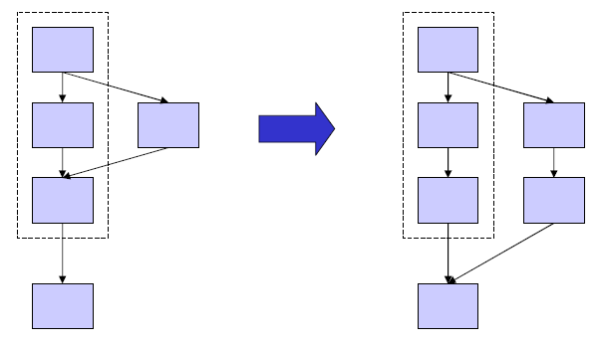
Superblock Scheduling
Trace: multiple entry, multiple exit block
Superblock: single-entry, multiple exit block
A trace with side entrances are eliminated
Infrequent paths do not interfere with the frequent path
+ More optimization/scheduling opportunity than traces
+ Eliminates “difficult” bookkeeping due to side entrances
Hwu+, “The Superblock: An Effective Technique for VLIW and superscalar compilation,” J of SC 1991.

Slide 61
Superblock Example
Could you have done this with a trace?
opA: mul r1,r2,3
opA: mul r1,r2,3
1
1
99
opB: add r2,r2,1
99
opB: add r2,r2,1
1
opC’: mul r3,r2,3
opC: mul r3,r2,3
opC: mul r3,r2,3
Original Code
Code After Superblock Formation
(using Tail Duplication)
opA: mul r1,r2,3
1
99
opB: add r2,r2,1
opC’: mul r3,r2,3
opC: mov r3,r1
Code After Common Subexpression Elimination

Slide 62
Superblock Scheduling Shortcomings
-- Still profile-dependent
-- No single frequently executed path if there is an unbiased branch
-- Reduces the size of superblocks
-- Code bloat and additional fix-up code executed
-- Due to side exits

Slide 63
Hyperblock Scheduling
Idea: Use predication support to eliminate unbiased branches and increase the size of superblocks
Hyperblock: A single-entry, multiple-exit block with internal control flow eliminated using predication (if-conversion)
Advantages
+ Reduces the effect of unbiased branches on scheduling block size
Disadvantages
-- Requires predicated execution support
-- All disadvantages of predicated execution

Slide 64
Hyperblock Formation (I)
10
Hyperblock formation
1. Block selection
2. Tail duplication
3. If-conversion
Block selection
Select subset of BBs for inclusion in HB
Difficult problem
Weighted cost/benefit function
Height overhead
Resource overhead
Dependency overhead
Branch elimination benefit
Weighted by frequency
Mahlke et al., “Effective Compiler Support for Predicated Execution Using the Hyperblock,” MICRO 1992.
BB1
90
80
20
BB2
BB3
80
20
BB4
10
BB5
90
10
BB6
10

Slide 65
Hyperblock Formation (II)
Tail duplication same as with Superblock formation
10
10
BB1
BB1
80
20
80
20
BB2
BB3
BB2
BB3
80
20
80
20
BB4
BB4
10
10
BB5
90
90
BB5
10
10
BB6
BB6
BB6’
90
81
9
10
9
1

Slide 66
Hyperblock Formation (III)
If-convert (predicate) intra-hyperblock branches
10
BB1
10
80
20
BB1
p1,p2 = CMPP
BB2
BB3
80
20
BB2 if p1
BB4
BB3 if p2
10
BB4
90
BB5
BB6
BB5
10
BB6
BB6’
81
9
10
81
BB6’
9
9
1
1

Slide 67
Aside: Test of Time
Mahlke et al., “Effective Compiler Support for Predicated Execution Using the Hyperblock,” MICRO 1992.
MICRO Test of Time Award
http://www.cs.cmu.edu/~yixinluo/new_home/2014-Micro-ToT.html

Slide 68
Can We Do Better?
Hyperblock still has disadvantages
Profile dependent (Optimizes for a single path)
Requires fix-up code
And, it requires predication support
Can we do even better?
Solution: Single-entry, single-exit enlarged blocks
Block-structured ISA: atomic enlarged blocks

Slide 69
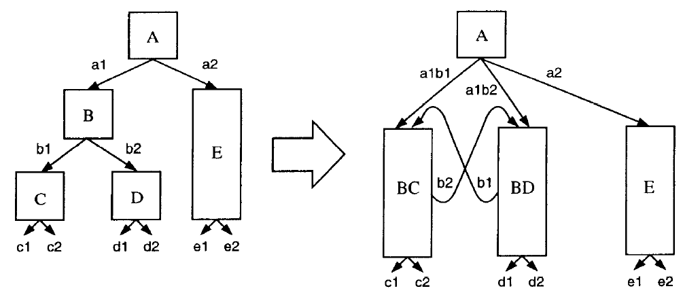
Block Structured ISA
Blocks (> instructions) are atomic (all-or-none) operations
Either all of the block is committed or none of it
Compiler enlarges blocks by combining basic blocks with their control flow successors
Branches within the enlarged block converted to “fault” operations → if the fault operation evaluates to true, the block is discarded and the target of fault is fetched
Melvin and Patt, “Enhancing Instruction Scheduling with a Block-Structured ISA,” IJPP 1995.

Slide 70
Block Structured ISA (II)
Advantages
+ Large atomic blocks
→ Aggressive compiler optimizations (e.g. reordering) can be enabled within atomic blocks (no side entries or exits)
→ Larger units can be fetched from I-cache → wide fetch
+ Can dynamically predict which optimized atomic block is executed using a “branch predictor”
→ can optimize multiple “hot” paths
+ No compensation (fix-up) code
Disadvantages
-- “Fault operations” can lead wasted work (atomicity)
-- Code bloat (multiple copies of the same basic block exists in the binary and possibly in I-cache)
-- Need to predict which enlarged block comes next

Slide 71
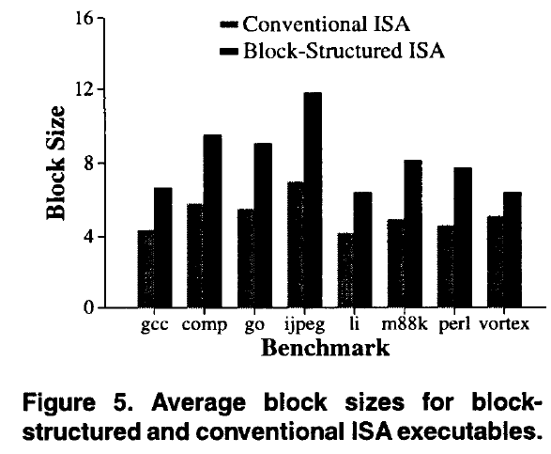
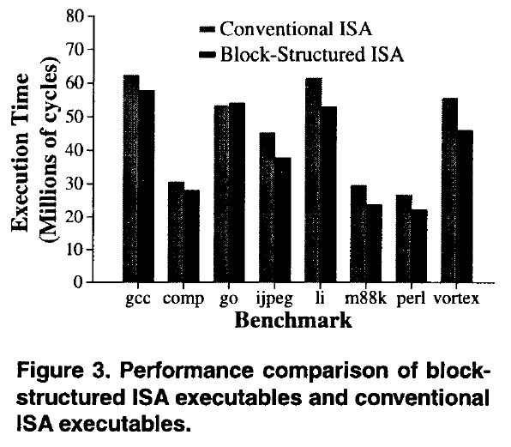
Block Structured ISA (III)
Hao et al., “Increasing the instruction fetch rate via block-structured instruction set architectures,” MICRO 1996.

Slide 72
Superblock vs. BS-ISA
Superblock
Single-entry, multiple exit code block
Not atomic
Compiler inserts fix-up code on superblock side exit
Only one path optimized (hardware has no choice to pick dynamically)
BS-ISA blocks
Single-entry, single exit
Atomic
Need to roll back to the beginning of the block on fault
Multiple paths optimized (hardware has a choice to pick)

Slide 73
Superblock vs. BS-ISA
Superblock
+ No ISA support needed
-- Optimizes for only 1 frequently executed path
-- Not good if dynamic path deviates from profiled path → missed opportunity to optimize another path
Block Structured ISA
+ Enables optimization of multiple paths and their dynamic selection.
+ Dynamic prediction to choose the next enlarged block. Can dynamically adapt to changes in frequently executed paths at run-time
+ Atomicity can enable more aggressive code optimization
-- Code bloat becomes severe as more blocks are combined
-- Requires “next enlarged block” prediction, ISA+HW support
-- More wasted work on “fault” due to atomicity requirement

Slide 74
Summary: Larger Code Blocks

Slide 75
Summary and Questions
Trace, superblock, hyperblock, block-structured ISA
How many entries, how many exits does each of them have?
What are the corresponding benefits and downsides?
What are the common benefits?
Enable and enlarge the scope of code optimizations
Reduce fetch breaks; increase fetch rate
What are the common downsides?
Code bloat (code size increase)
Wasted work if control flow deviates from enlarged block’s path

Slide 76
We did not cover the following slides in lecture. These are for your preparation for the next lecture.

Slide 77
IA-64: A “Complicated” VLIW ISA
Recommended reading:
Huck et al., “Introducing the IA-64 Architecture,” IEEE Micro 2000.

Slide 78
EPIC – Intel IA-64 Architecture
Gets rid of lock-step execution of instructions within a VLIW instruction
Idea: More ISA support for static scheduling and parallelization
Specify dependencies within and between VLIW instructions (explicitly parallel)
+ No lock-step execution
+ Static reordering of stores and loads + dynamic checking
-- Hardware needs to perform dependency checking (albeit aided by software)
-- Other disadvantages of VLIW still exist
Huck et al., “Introducing the IA-64 Architecture,” IEEE Micro, Sep/Oct 2000.

Slide 79


IA-64 Instructions
IA-64 “Bundle” (~EPIC Instruction)
Total of 128 bits
Contains three IA-64 instructions
Template bits in each bundle specify dependencies within a bundle
\
IA-64 Instruction
Fixed-length 41 bits long
Contains three 7-bit register specifiers
Contains a 6-bit field for specifying one of the 64 one-bit predicate registers

Slide 80
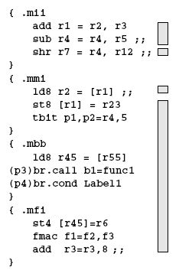
IA-64 Instruction Bundles and Groups
Groups of instructions can be executed safely in parallel
Marked by “stop bits”
Bundles are for packaging
Groups can span multiple bundles
Alleviates recompilation need somewhat

Slide 81
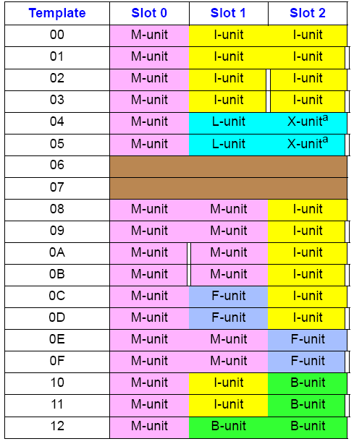
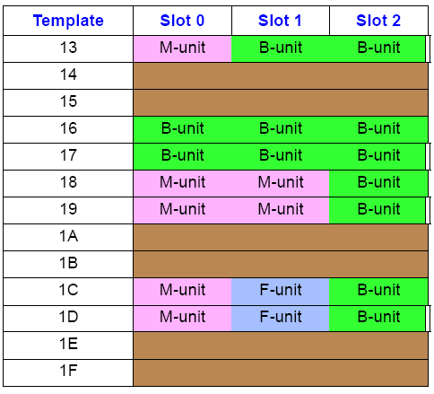
Template Bits
Specify two things
Stop information: Boundary of independent instructions
Functional unit information: Where should each instruction be routed

Slide 82
Non-Faulting Loads and Exception Propagation
ld.s (speculative load) fetches speculatively from memory
i.e. any exception due to ld.s is suppressed
If ld.s r1 did not cause an exception then chk.s r1 is a NOP, else a branch is taken (to execute some compensation code)
ld.s r1=[a]
inst 1
inst 2
….
br
inst 1
inst 2
….
unsafe
code
motion
br
….
ld r1=[a]
use=r1
….
chk.s r1
use=r1
ld r1=[a]

Slide 83
Non-Faulting Loads and Exception Propagation in IA-64
Load data can be speculatively consumed prior to check
“speculation” status is propagated with speculated data
Any instruction that uses a speculative result also becomes speculative itself (i.e. suppressed exceptions)
chk.s checks the entire dataflow sequence for exceptions
ld.s r1=[a]
inst 1
inst 2
use=r1
….
br
inst 1
inst 2
….
br
unsafe
code
motion
br
….
ld r1=[a]
use=r1
….
chk.s use
ld r1=[a]
use=r1

Slide 84
Aggressive ST-LD Reordering in IA-64
ld.a (advanced load) starts the monitoring of any store to the same address as the advanced load
If no aliasing has occurred since ld.a, ld.c is a NOP
If aliasing has occurred, ld.c re-loads from memory
inst 1
inst 2
….
st [?]
….
ld r1=[x]
use=r1
ld.a r1=[x]
inst 1
inst 2
….
st [?]
….
ld.c r1=[x]
use=r1
potential
aliasing
st[?]

Slide 85
Aggressive ST-LD Reordering in IA-64
inst 1
inst 2
….
st [?]
….
ld r1=[x]
use=r1
ld.a r1=[x]
inst 1
inst 2
use=r1
….
st [?]
….
chk.a X
….
potential
aliasing
st[?]
ld r1=[a]
use=r1

